Slide 1
Cardiovascular Disease Prediction: Machine Learning Models and Tableau
Presented by:
Ian Lloyd, Janki Shah, Crisaldry Brito Rodriguez,
Darya Naymon and Devorah Zweig

Slide 2
Project Statement
What is the possibility of a person getting a cardiovascular disease based on specific indicators?
The project aims to develop models that will provide predictions on if a person will get a cardiovascular disease [Model 1: Stroke, Model 2: Heart Failure] based on a series of questions asked.
The group analyzed two cardiovascular datasets, one looking at stroke and the other one looking at heart failure.

Slide 3
Framing and Objectives
Understanding the data
Processing for Data Visualization
Creating the Models
Indicating which variables have a significant effect on the likelihood of heart disease or stroke
Launching AWS Instance and Webpage for both Stroke and Heart Disease Tests

Slide 4
Process for Data Visualization
Data Visualization:
Using Tableau Charts to explore the relationships between various factors and stroke and heart failure
The charts helps gain deeper insights into the dataset and present findings effectively and targeted to stakeholders
Step by Step:
Clean up the data:
Removing duplicates and null values
Correcting Data Formats

Slide 5
Understanding the Data
Stroke Prediction Dataset:
Predict if a person is likely to suffer from a stroke due by analysing demographic, lifestyle choices, and medical information
Analyze the impact of factors such as age, gender, hypertension, smoking status, on stroke occurrence
Heart Disease Prediction Dataset:
Using the given dataset to determine how likely a person is to contract a heart disease based on a combination of medical information and personal choices. Some of the analyzed variables include BMI, stroke status and sex.

Slide 6
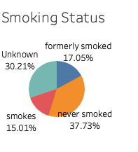
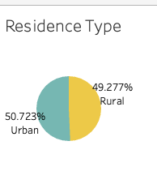
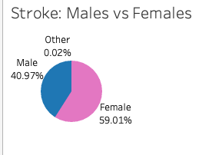
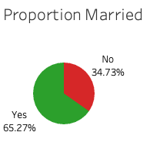
Understanding the Sample Groups: Stroke Dataset

Slide 7
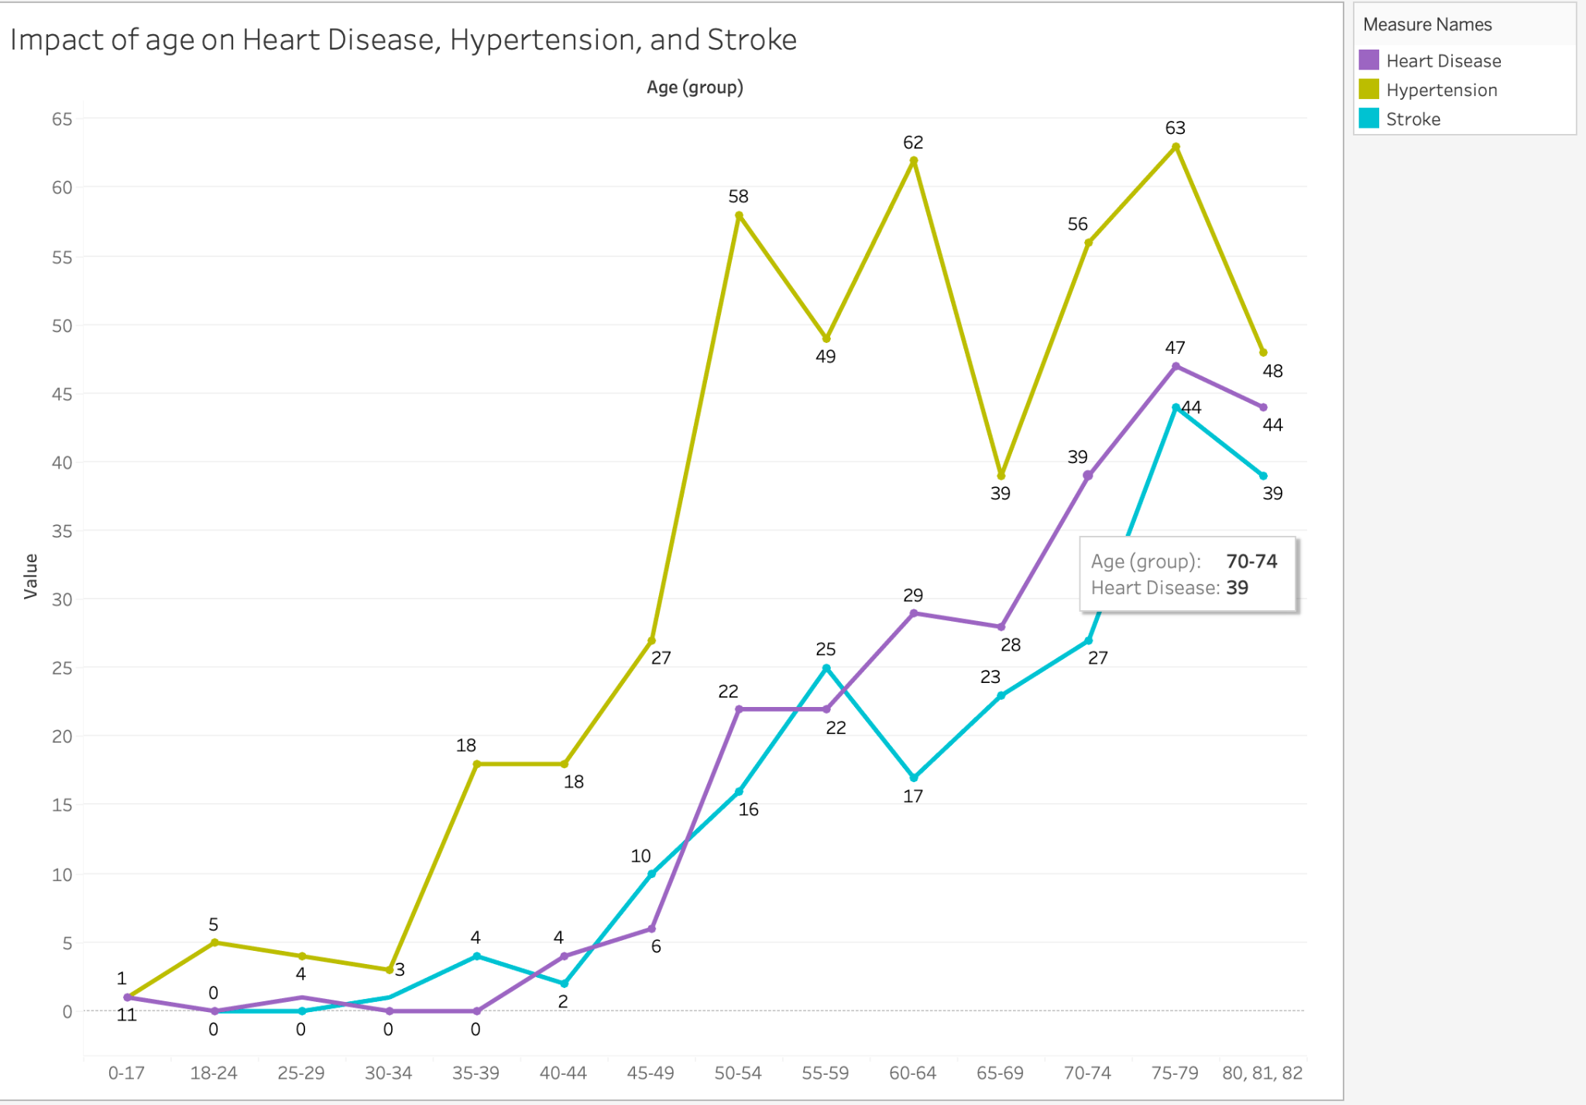
Impact of age on heart disease, hypertension, and stroke: Stroke Dataset
As individuals get older, their risk of experiencing cardiovascular diseases tends to increase. This is evident in the graph, which demonstrates that the highest number of affected individuals in the dataset is observed among those aged 70 and above

Slide 8
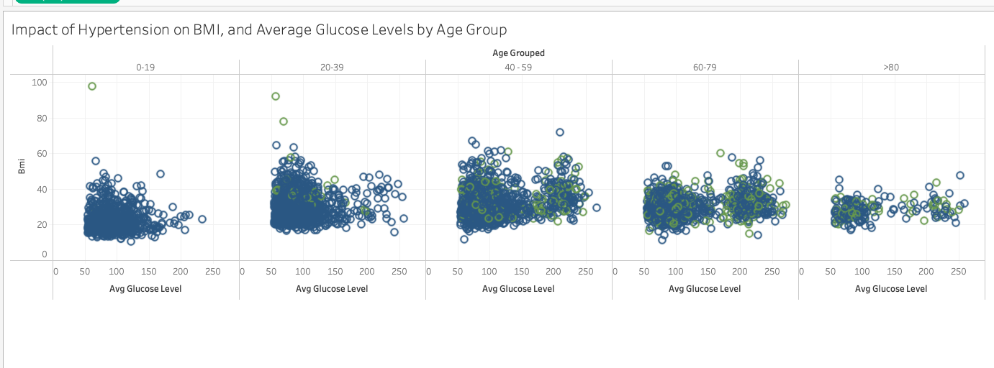
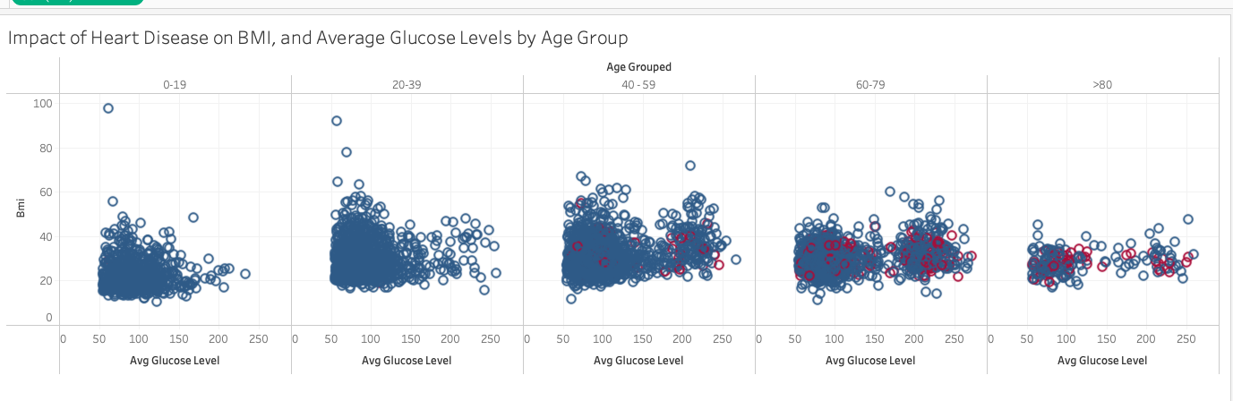

Slide 9
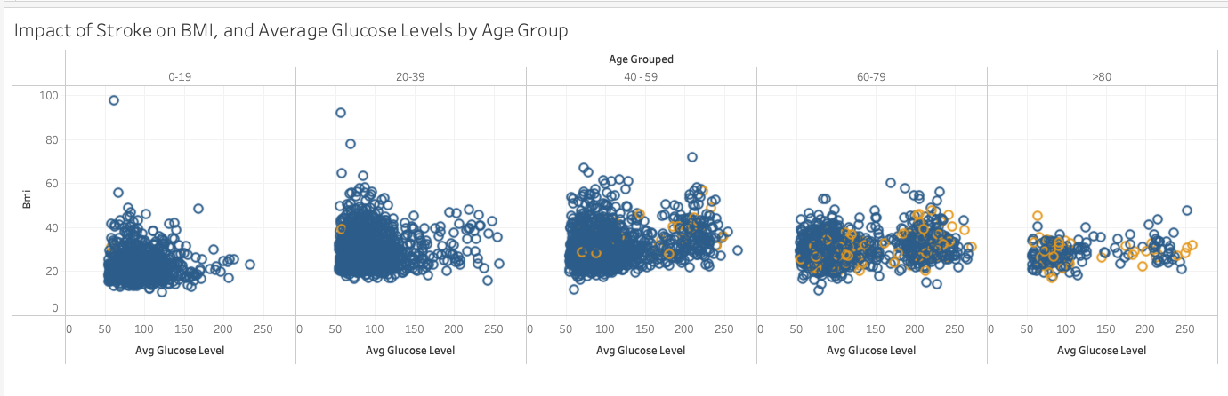
BMI, Glucose Levels and Heart Disease by age group
The colored data markers in the graphs represent individuals with specific health conditions, such as Heart Disease, Hypertension, or Strokes. These markers are used to visually differentiate and highlight the data points corresponding to individuals with these particular conditions.
Through the visualizations, it becomes evident that as individuals age, they become more susceptible to these diseases. The increasing prevalence of the colored data markers as age increases indicates a higher likelihood of developing these conditions among older individuals. This trend is observable across the various visualizations, providing clear evidence of the correlation between age and the risk of developing cardiovascular diseases.

Slide 10
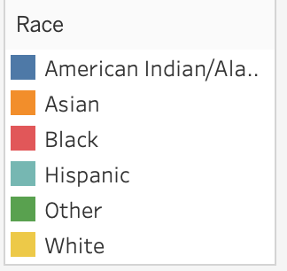
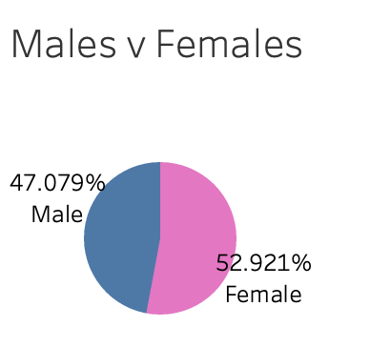
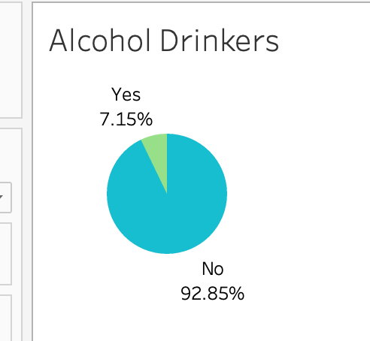
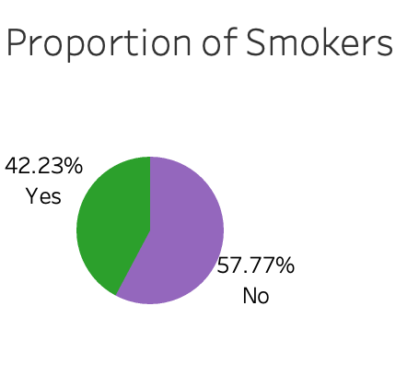
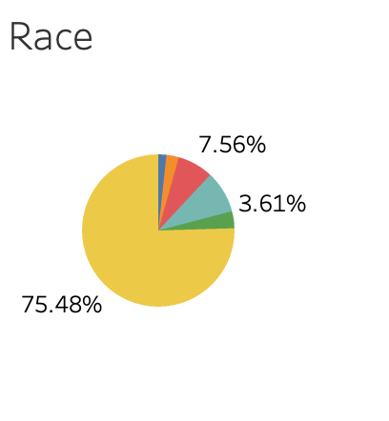
Understanding the Sample Groups: Heart Disease Dataset

Slide 11
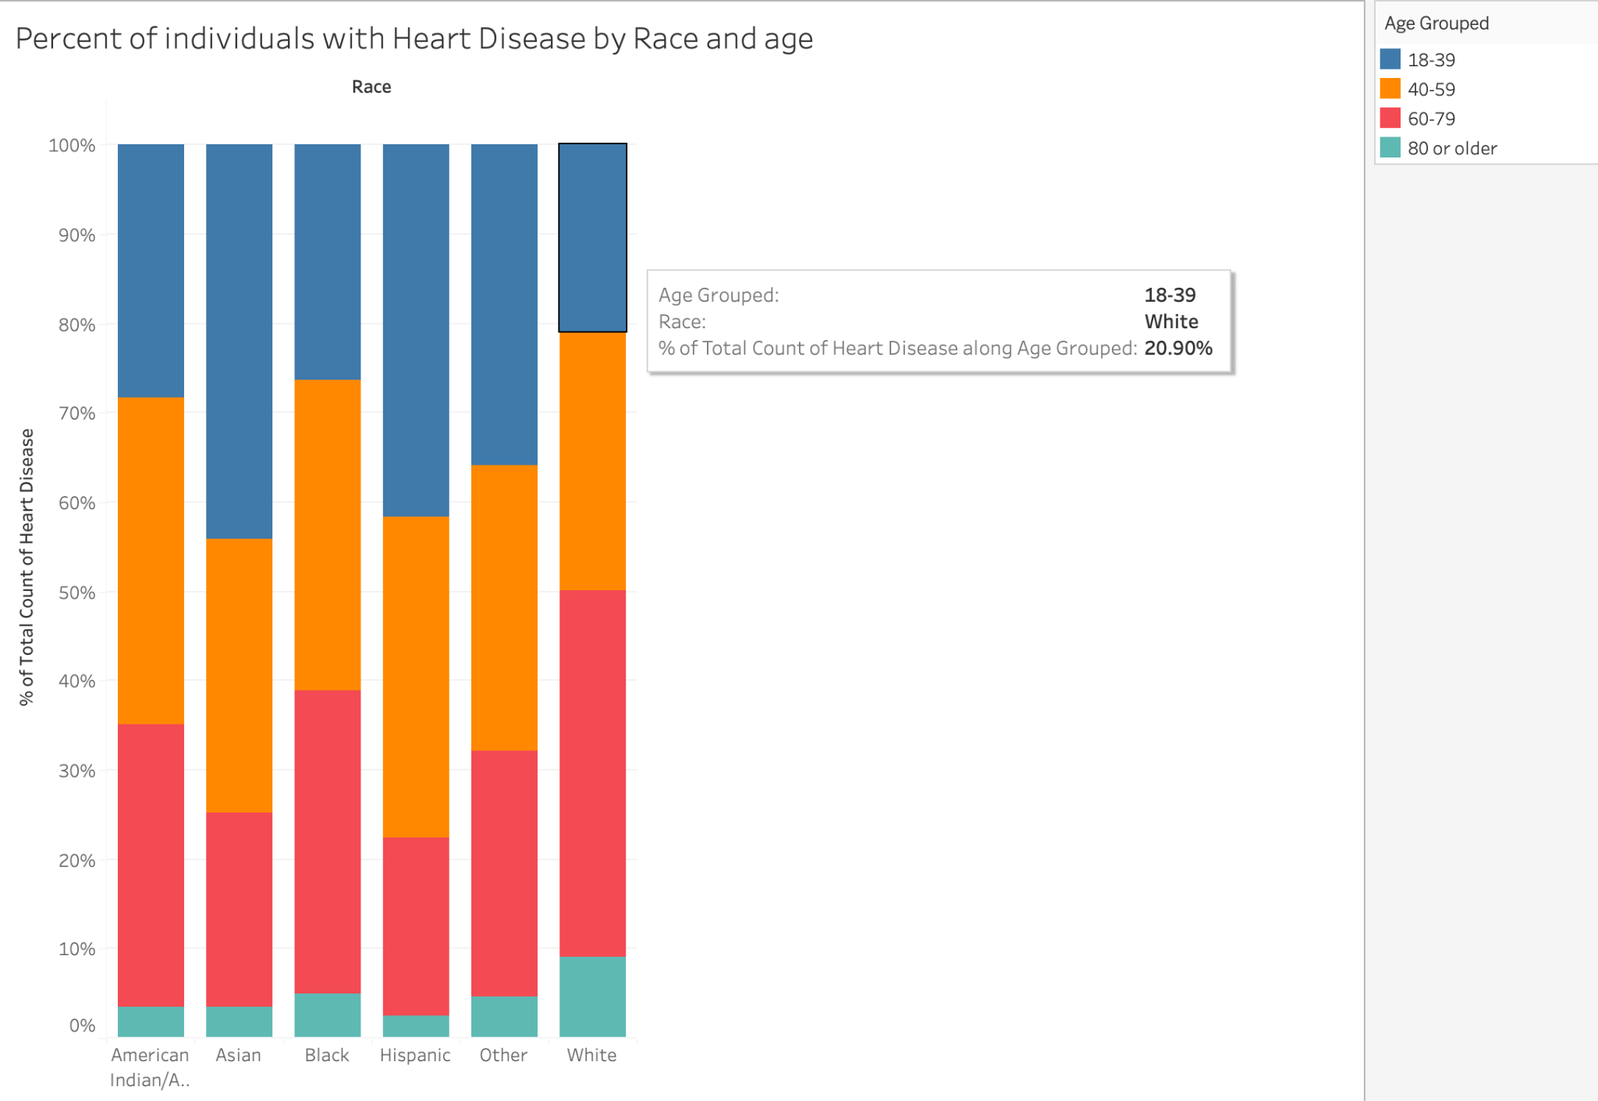
The comparison is not entirely fair because the dataset primarily consists of white individuals [75.48%]. Different races are not equally represented. However, it's worth noting that among younger Asian and Hispanic individuals, the likelihood of developing heart disease is higher compared to white individuals.

Slide 12
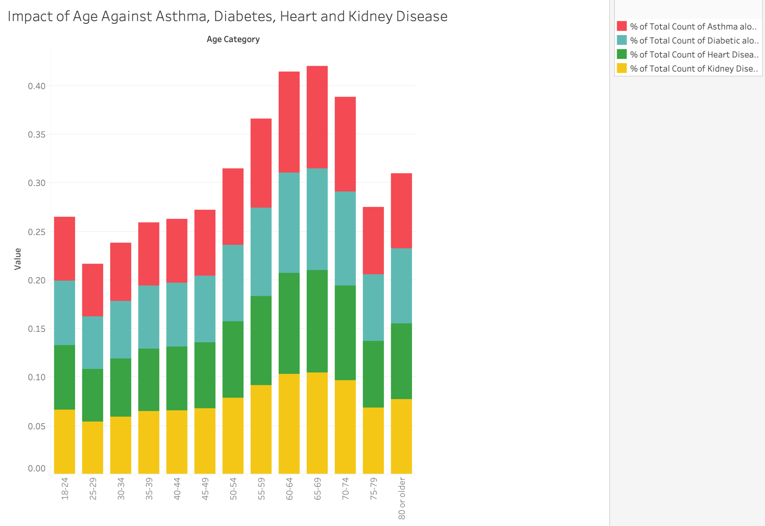
According to the data set, the highest prevalence of heart disease, diabetes, asthma, and kidney disease occurs among individuals aged 50 to 75. Additionally, there is a decrease in the incidence of these tracked diseases from the age range of 70-74 to 75-79.

Slide 13
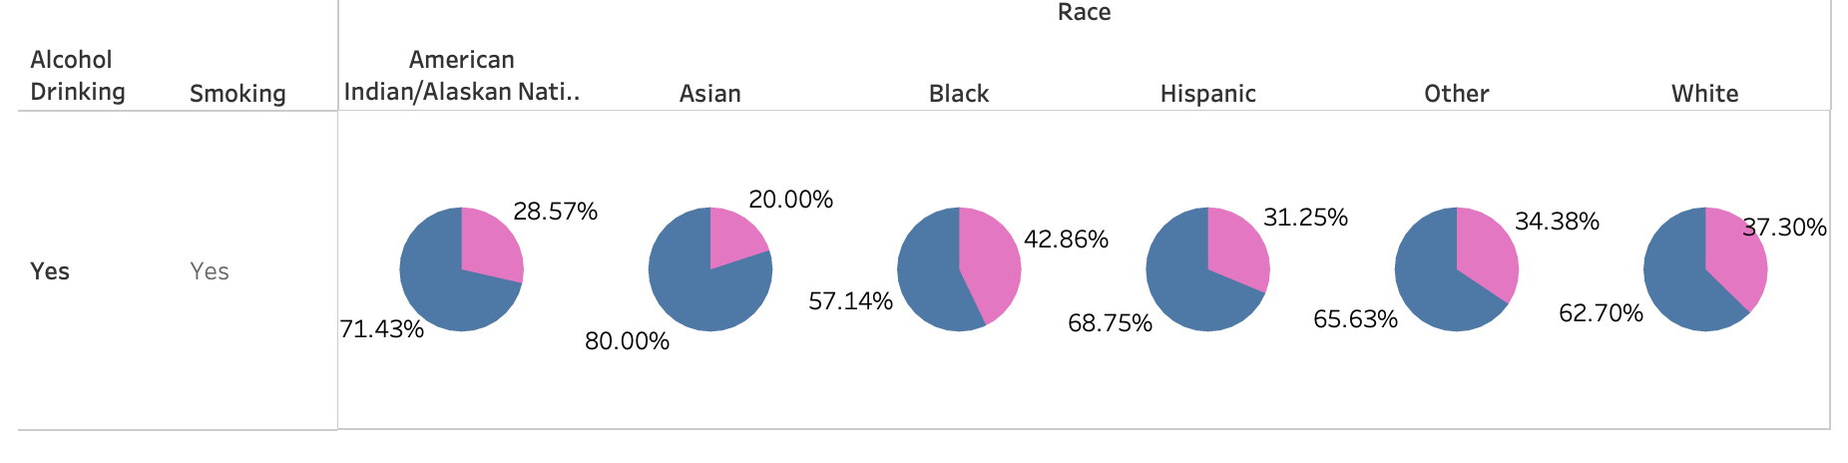
Analyzing the data set, we can observe that among alcohol drinkers and smokers, males constitute the majority of individuals with heart disease.
In terms of race, both Asian and American Indian males represent more than 70% of heart disease cases within their respective racial groups. Similarly, amongst the observed races, Black women and White women, account for over 37% of individuals affected by heart disease within their racial categories.

Slide 14
What is Stroke?
A stroke occurs when something blocks blood supply to part of the brain or when blood vessel in the brain bursts.
In either case, parts of brain become damaged or die.
And this can cause lasting brain damage, long-term disability or even death.
CDC says, “Time lost is brain lost. Every minute counts.”
But detecting a stroke in its early stages brings numerous advantages like reduce brain damages and other complications , prevent disability and in some cases even deaths.
Our goal is to create machine learning model for early detection of Stroke.

Slide 15
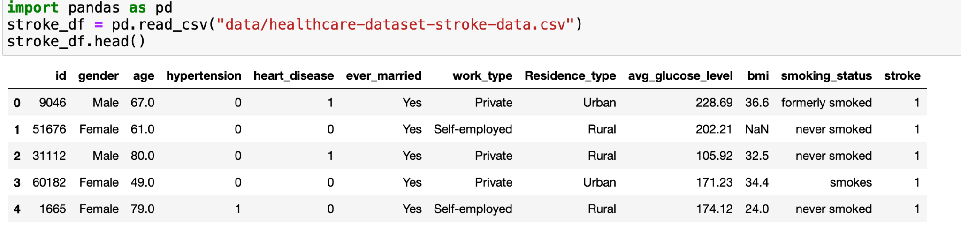
Stroke Dataset ETL - Extract
Extracted the data from Kaggle
Dataset has about 5100 Entries and 12 Columns
Dataset contains numeric and categorical values

Slide 16
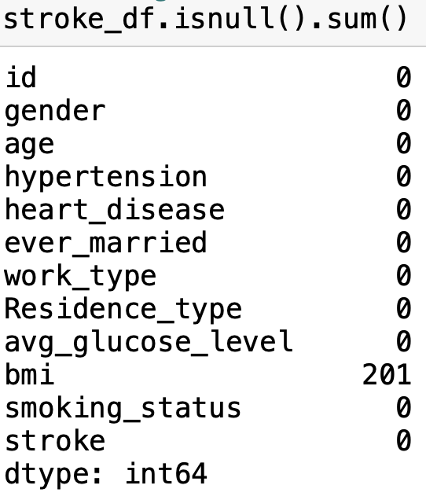
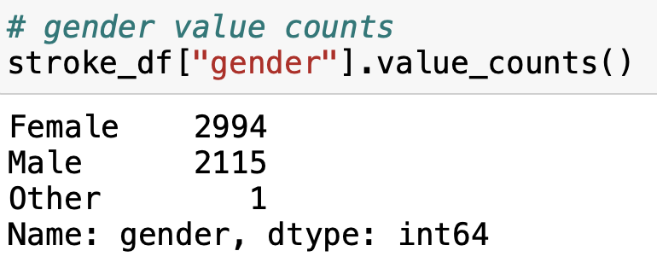
Stroke Dataset ETL - Transform
Cleaned the dataset for further analysis
Found some NaNs in the bmi column
Used fillna() method with mean bim for each age .
Dropped the id column which has no impact on data analysis
Dropped entry from Gender column where it said Other (since it was just 1 instance)

Slide 17
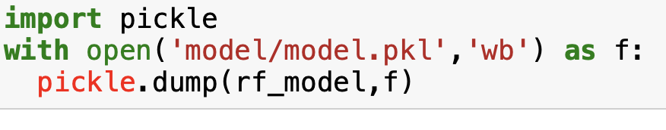
Stroke Dataset ETL - Load
Loaded clean data to the Sqlite Database
After running the classification algorithms on cleaned dataset, I stored the model in pickle files for our disease prediction API.
The final model acquired 98.9% accuracy score.

Slide 18
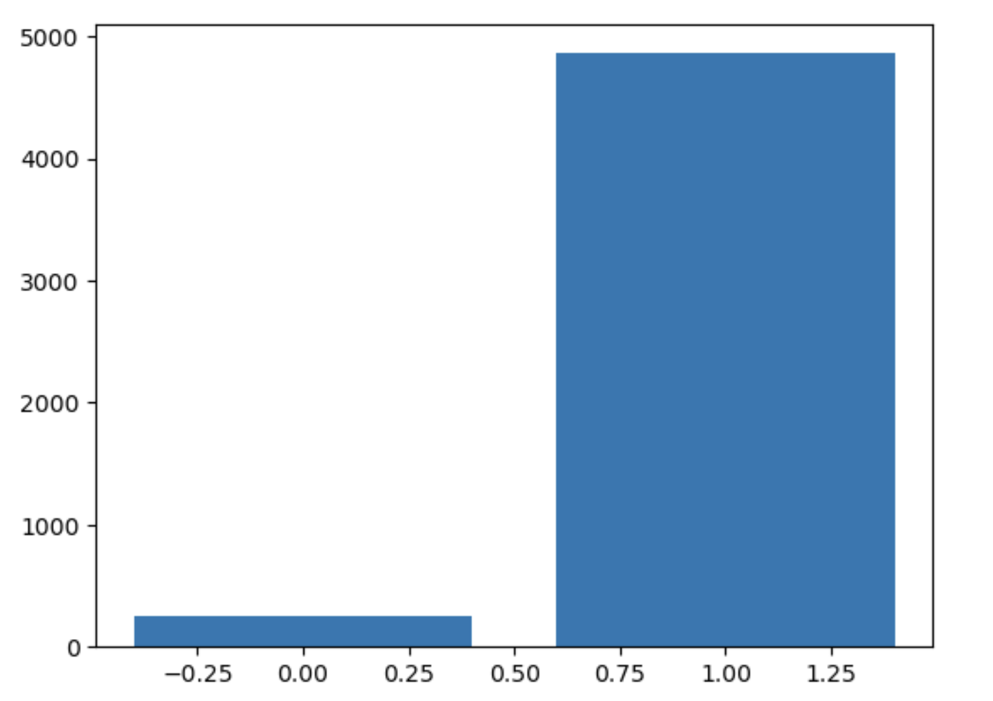
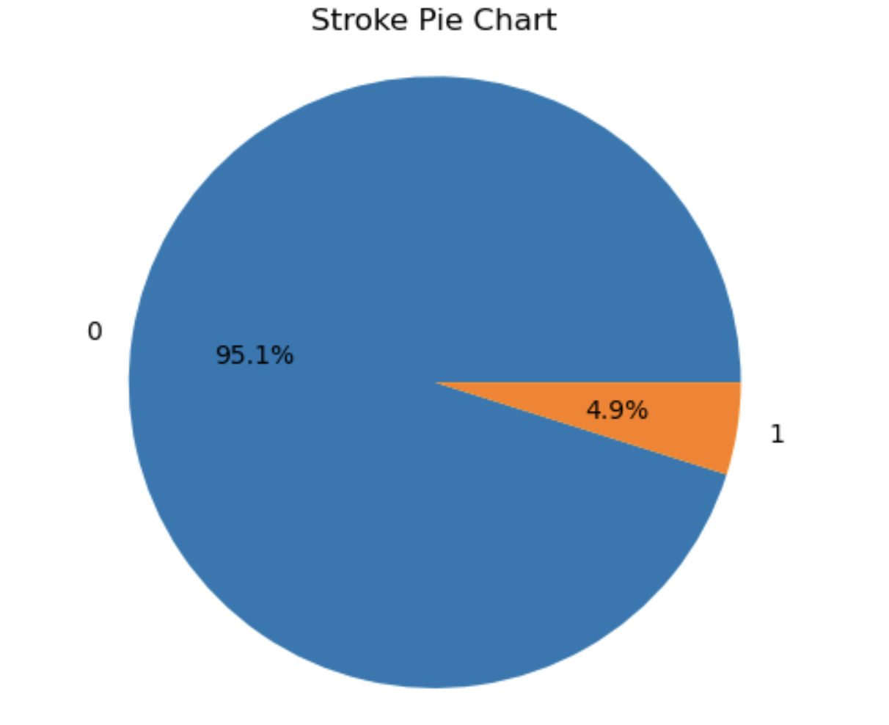
Stroke Data Analysis For Target Variable
As you can see that stroke dataset is highly imbalanced
Challenges related to imbalanced dataset are a) Biased Predictions and b) Misleading Accuracy

Slide 19
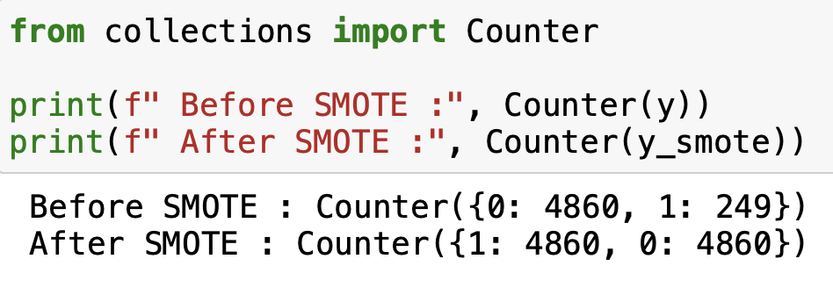
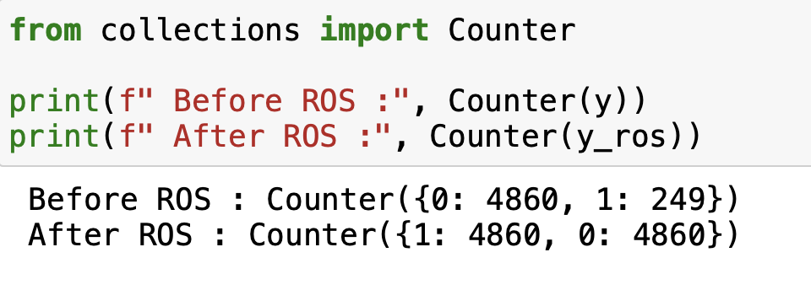
Steps to Mitigating Imbalance Dataset
To overcome this problem, I used SMOTE (Synthetic Minority Oversampling Technique) and random oversampling techniques with different classification algorithms.
As you can , I have oversampled the minority class by resampling.

Slide 20
Stroke - Flow of building the models
Extracted data from data source
Cleaned up the data
Observed the data distribution
Converted categorical data to numeric data with pd.get_dummies()
Applied oversampling techniques with smot.fit_resample() and ros.fit_resample()
Scaled the data using scaler.fit_tranform()
Split the data into train and test datasets
Train the model - Test the model - Make Predictions with Decision Tree and Random Forest classifiers.

Slide 21
Stroke - Accuracy Scores
 | Accuracy Score | Precision | Recall | F1-score
Model-1 SMOTE+Decision Tree | 94.32% | 0.95 | 0.93 | 0.94 | No Stroke
 |  | 0.93 | 0.96 | 0.94 | Stroke
Model-2 SMOTE+RandomForest | 97.32% | 0.96 | 0.99 | 0.97 | No-Stroke
 |  | 0.99 | 0.96 | 0.97 | Stroke
Model-3 ROS+DecisionTree | 97.16% | 1.00 | 0.94 | 0.97 | No-Stroke
 |  | 0.95 | 1.00 | 0.97 | Stroke
Model-4 ROS+RandomForest | 98.97% | 1.00 | 0.98 | 0.99 | No-Stroke
 |  | 0.98 | 1.00 | 0.99 | Stroke

Slide 22
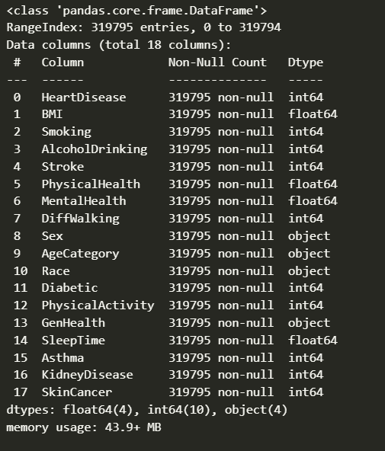
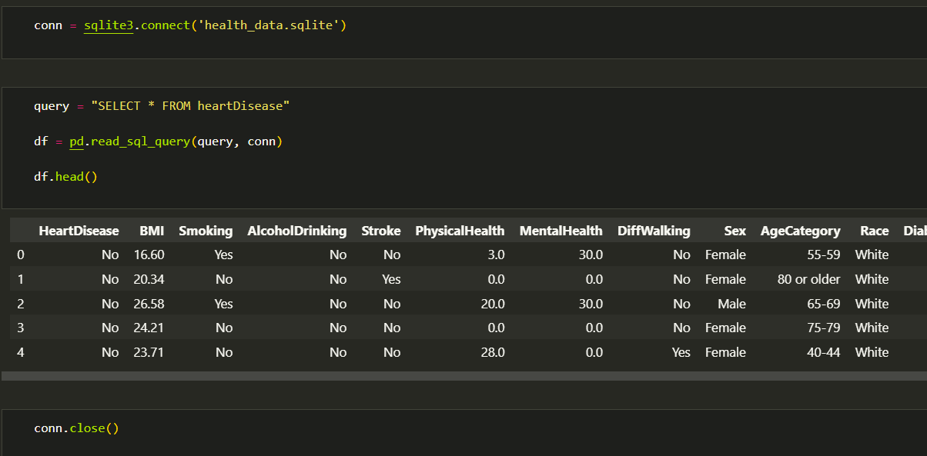
Heart Disease - Data Extraction

Slide 23
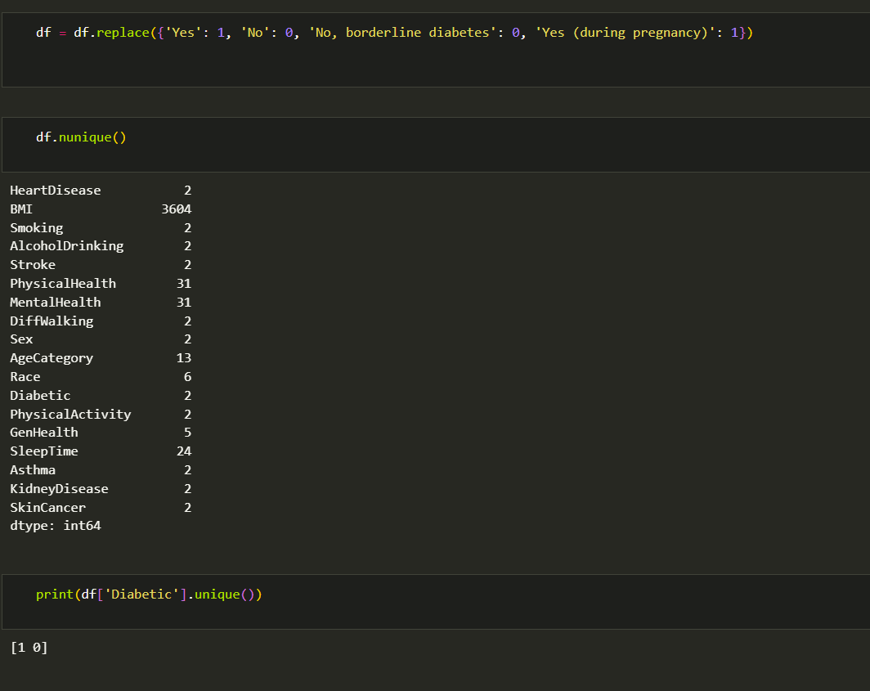
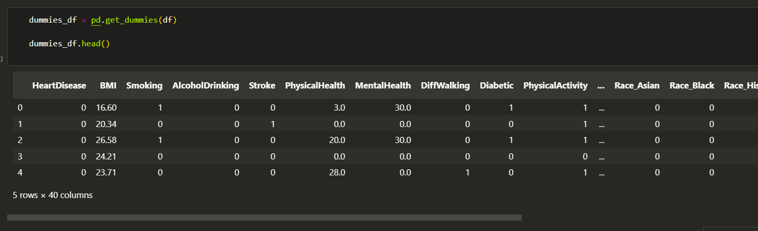
Data Transformation

Slide 24
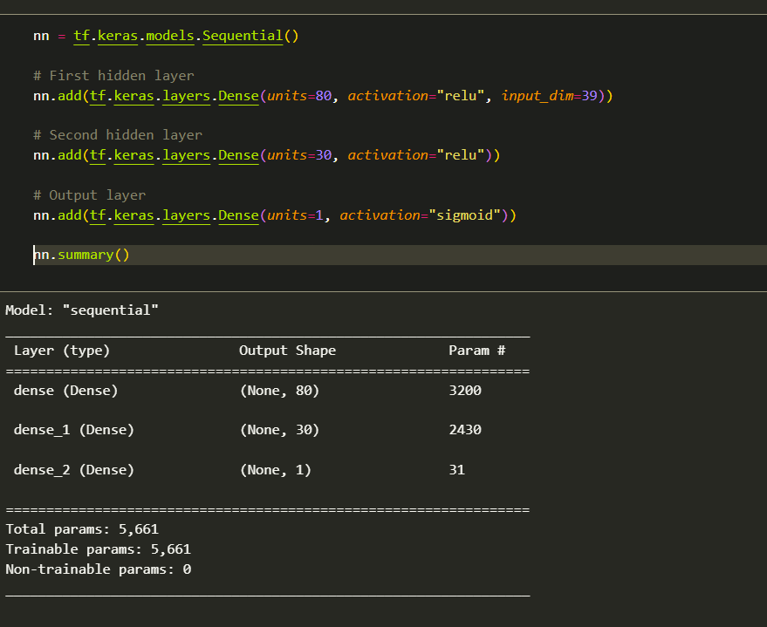
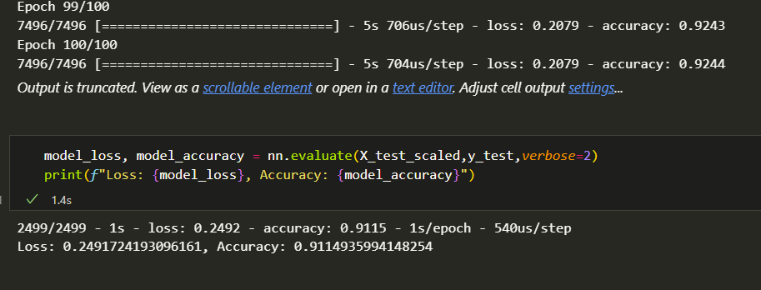
Heart Disease - Model 1

Slide 25
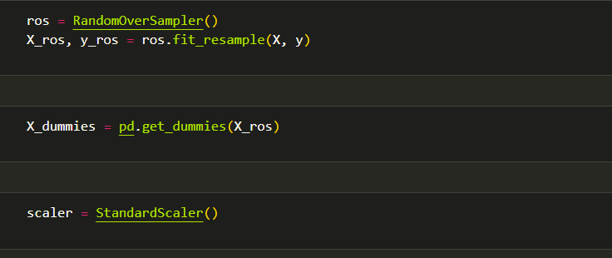
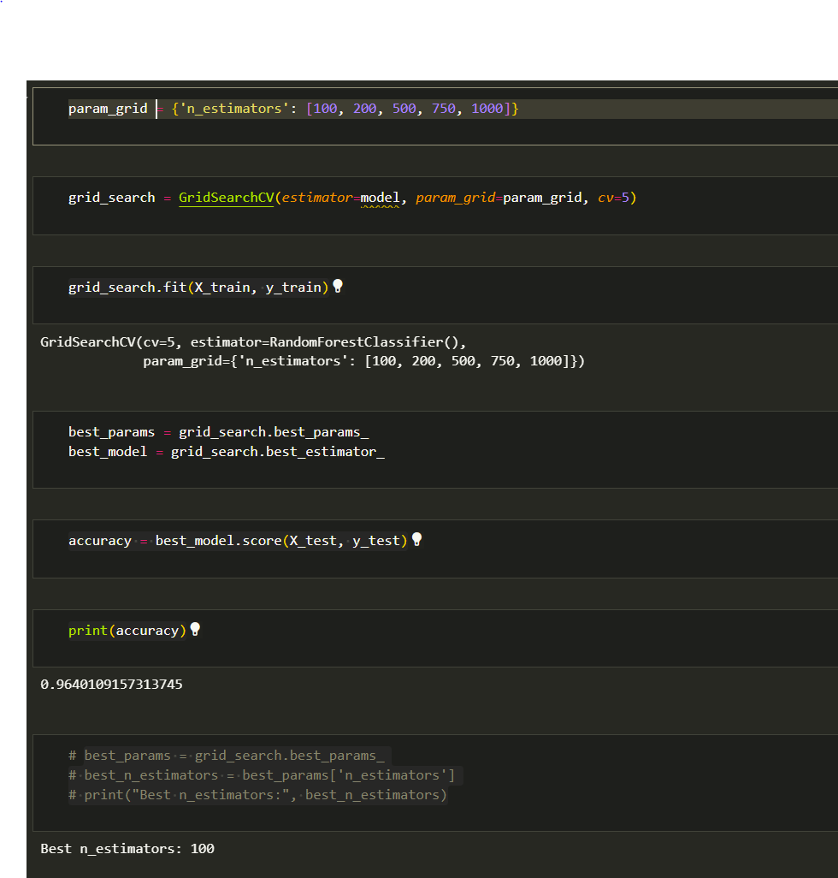
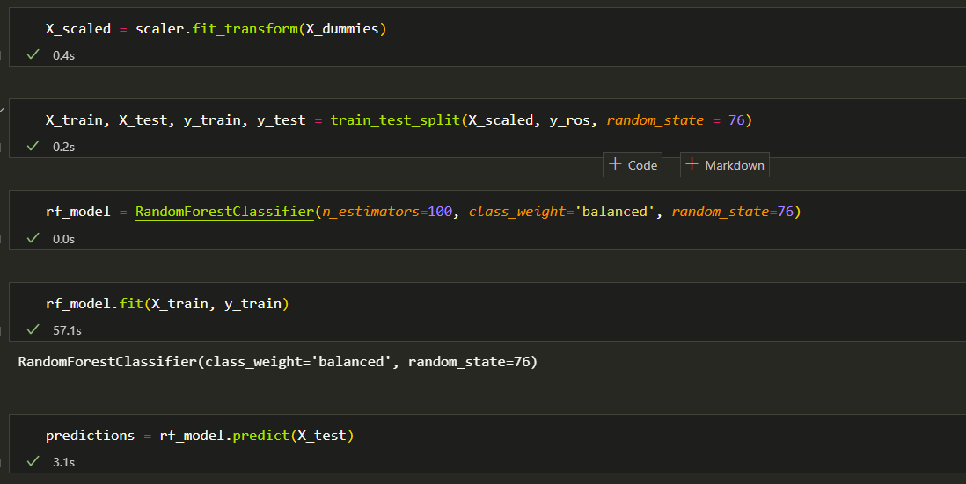
Heart Disease - Model 2

Slide 26
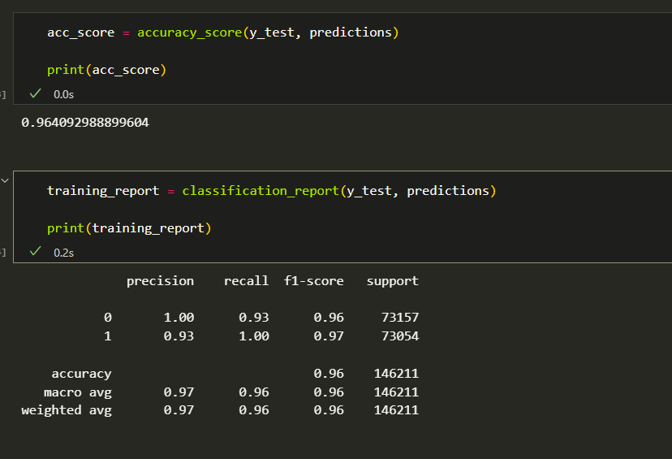
Heart Disease - Model 2

Slide 27
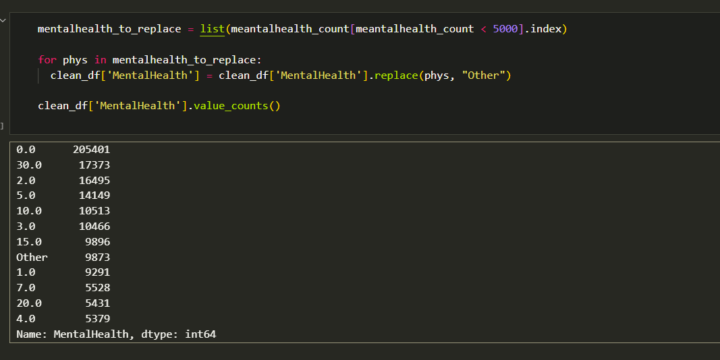
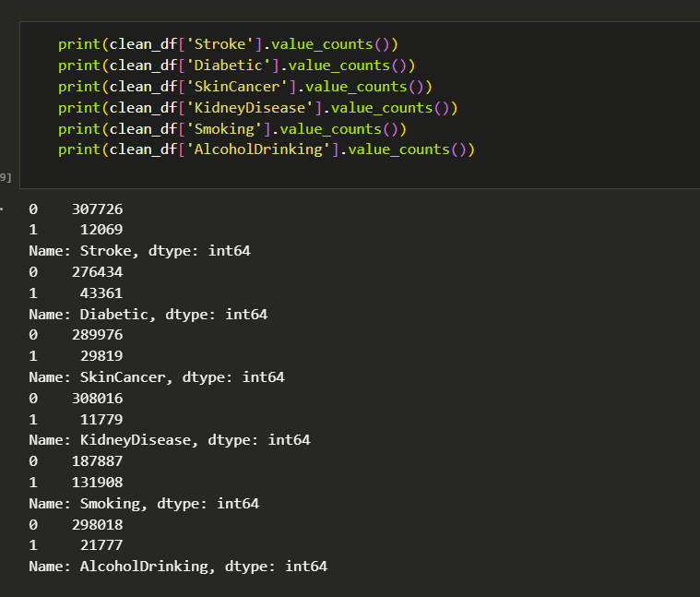
Attempts to Make Adjustments to Data Set

Slide 28
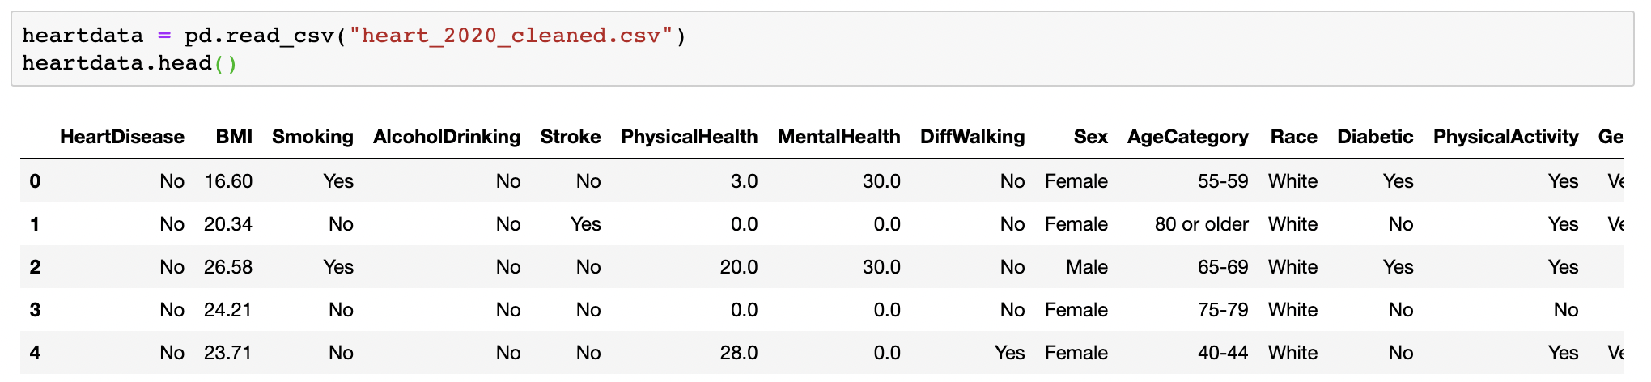
Alternate Machine Learning Models
In additional to the previously mentioned models, several other models were developed using the Heart Disease dataset.
To start with, the data was extracted, and then cleaned and organized.

Slide 29
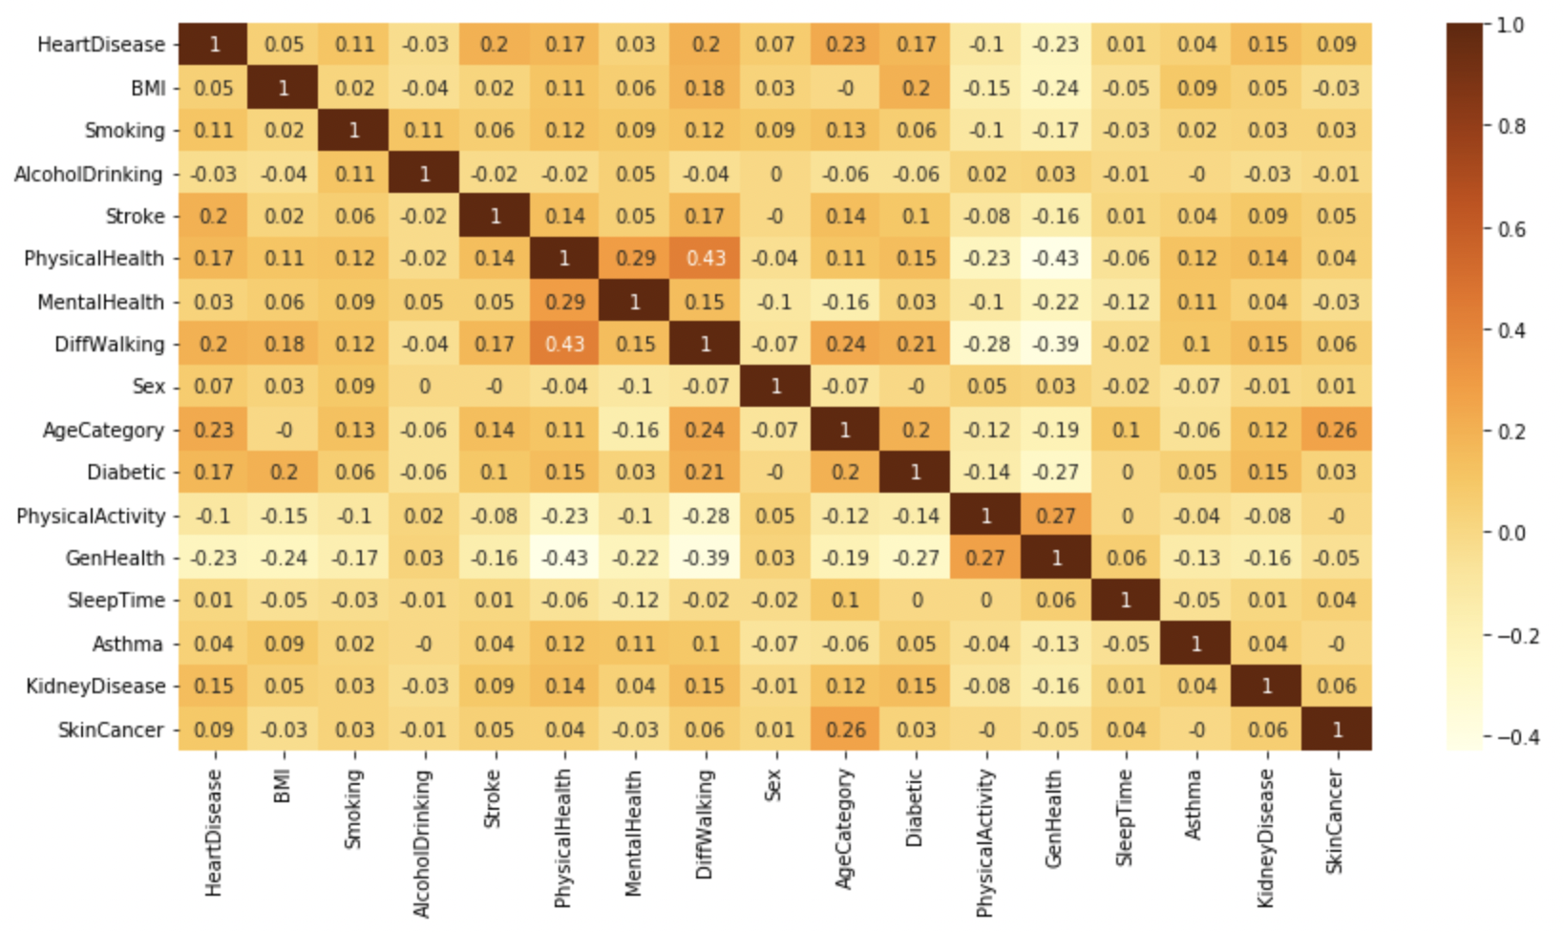
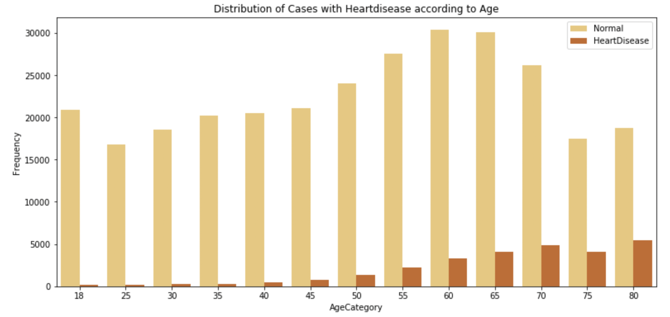
Identifying Important Variables

Slide 30
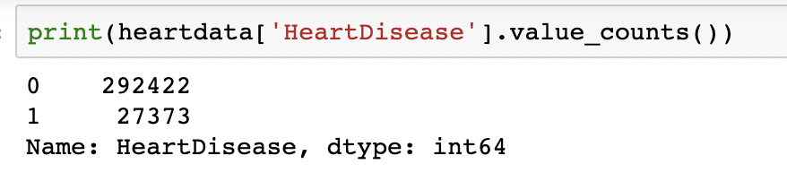
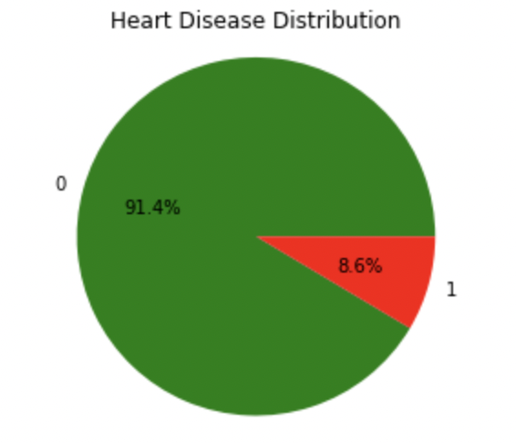
Understanding the Target Variable
The next step was understanding the population through the dataset that was found.
After finding the count of the people that had a heart disease vs. the amount that didn’t, a pie chart was created to visualize the percentage of each.
It can be seen here that the data is imbalance. Because of this, SMOTE was used to balance it.

Slide 31
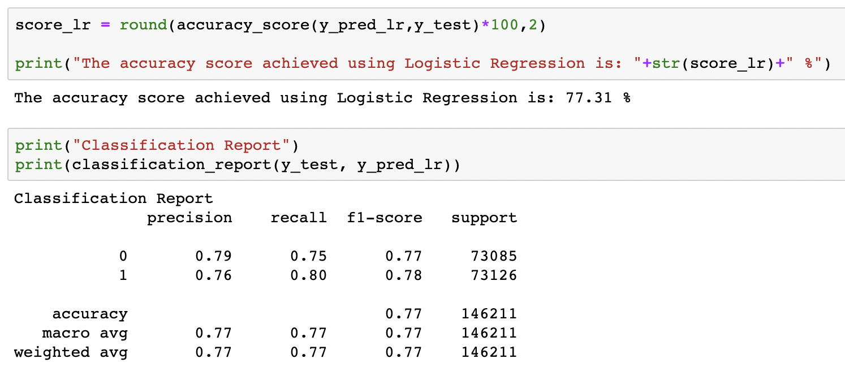
Creating the Models: Model 1
The first model used was LogisticRegression.
After running the analysis using the X and y variables, it was found to have an accuracy of 77%.

Slide 32
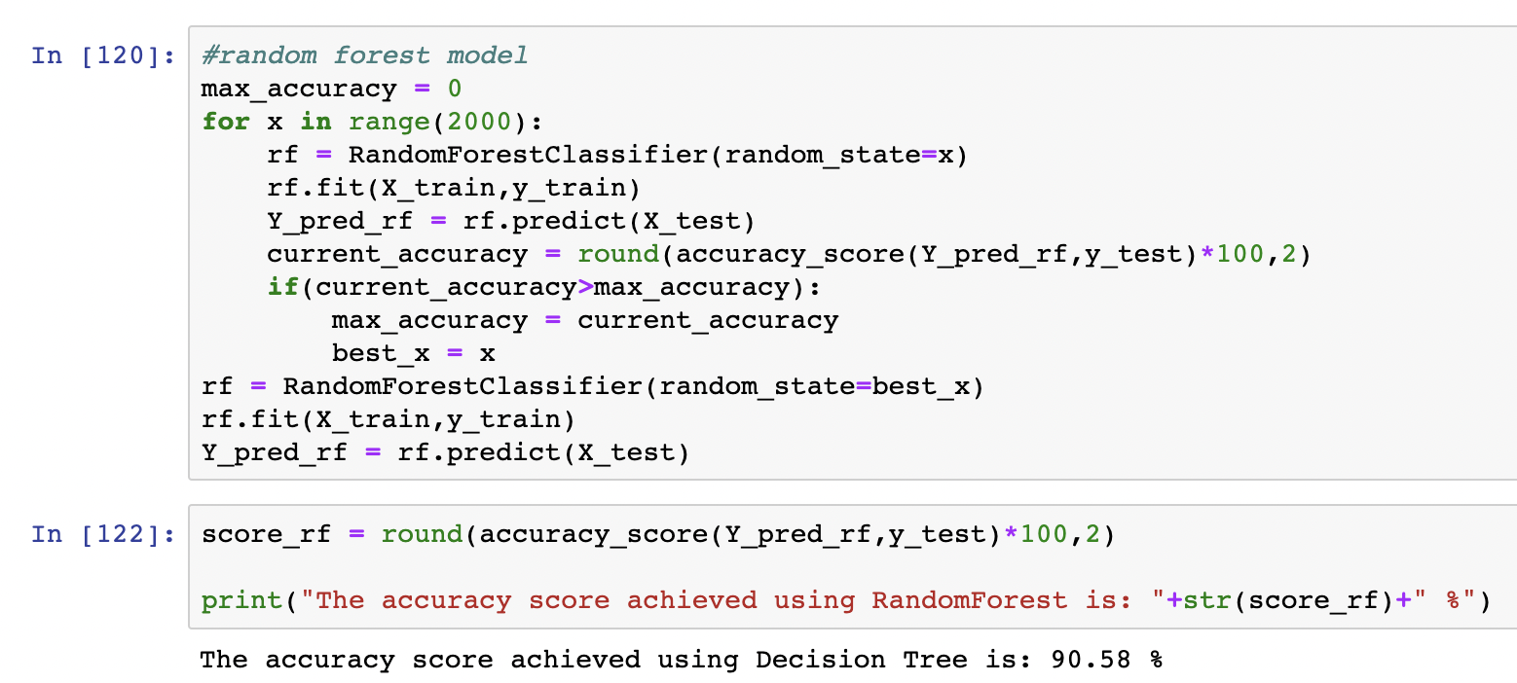
Creating the Models: Part 2
The other model used was RandomForestClassifier.
After running the code, it was found to have about 91% accuracy.

Slide 33
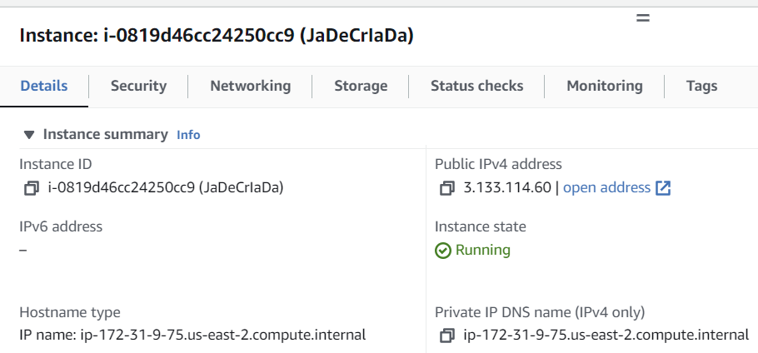
Launching AWS Instance
Launching an AWS instance involved the process of creating and initializing a virtual server in the Amazon Elastic Compute Cloud (EC2) service.
Configuring Instance Details - selecting the virtual network, security groups, user data scripts, and metadata.
Configuring security - the rules for protocols, ports, and destination IP address
Creating key pair is for securely accessing our instance using SSH.
Waiting for instance to reach the "running" state and using ID to view more details.

Slide 34
Launching https://jadecriada-test.bubbleapps.io/
Creating a new application on bubble.io
Designing web page and Customizing the elements on the canvas to customize their properties, such as text, styles, colors, and sizes
Installing the AWS API Connector plugin: In the "Plugins" tab, searching for the "AWS API Connector" plugin.
Create workflows by selecting an element, choosing an event (e.g., button click), and specifying the actions or conditions to be performed. Setting up the appropriate workflows to trigger the API calls
Using API data in Bubble.io: Once the API call is made, we can handle the API response within Bubble.io. This allows displaying models test results on the webpage.

Slide 35
Data Limitations
The Heart Disease datasets contains more indicators than the Stroke dataset.
There are fields in the stroke data set that are more detailed than in Heart Disease Dataset.
For example: The smoker dataset allowed subjects to specify what category of smoker they were [ie former smoker, never smoked…]
The stroke data set included subjects less than 18 years old
The Heart Disease data set included additional demographic fields
For example, Race. The majority of the subjects were white

Slide 36
Conclusion
Models generated from these datasets provide highly accurate ways to measure whether or not a person is at-risk for a stroke or heart disease.
While these models do not definitively determine whether or not a person will have a stroke or contract heart disease, they can be a useful tool for helping physicians and individuals determine whether or not they should take steps to lessen their risk.

Slide 37
Citations
Kaggle. (n.d.). Stroke Prediction Dataset. Retrieved from https://www.kaggle.com/datasets/fedesoriano/stroke-prediction-dataset?resource=download&select=healthcare-dataset-stroke-data.csv
Pytlak, K. (n.d.). Personal Key Indicators of Heart Disease. Retrieved from https://www.kaggle.com/datasets/kamilpytlak/personal-key-indicators-of-heart-disease?resource=download

